Slide 1
Bluetooth remote control
Mathieu Stephan, EPFL

Slide 2
Why?
BT
LCD screen
Create a complete product
Remotely control your music player
Get information about the tracks being played
Get calls / listen to the music on your remote control
Provide advanced functionalities using the USB port
Provide a platform with free tools
USB
Buttons
Audio

Slide 3
/!\ INFORMATION /!\
This project is made from scratch

Slide 4
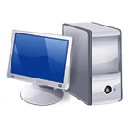
General idea
Analog
Bluetooth
Audio CODEC
Bluetooth
?
Microcontroller
LCD screen
USB
Buttons

Slide 5
Components’ choice
AT90USB1287: 8Mhz, 128kb flash memory, embedded USB bootloader, free compiler (WinAVR)
LMX9838: Bluetooth to UART converter with embedded antenna, Serial Port Profile
Winbond W681310: cheap audio codec supported by the LMX9838
Nokia Color LCD: cheap 130*130 pixels screen interfaced using SPI bus

Slide 6
Interfacing the components
PCM
Analog
LMX9838
W68310
Bluetooth
UART
AT90USB1287
LCD screen
USB
SPI
Buttons

Slide 7
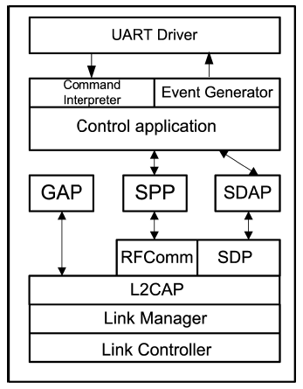
Bluetooth point of view
Remote control
Winamp
UART
Serial port
Bluetooth application
Windows drivers
2.4 Ghz
USB
BT Dongle

Slide 8
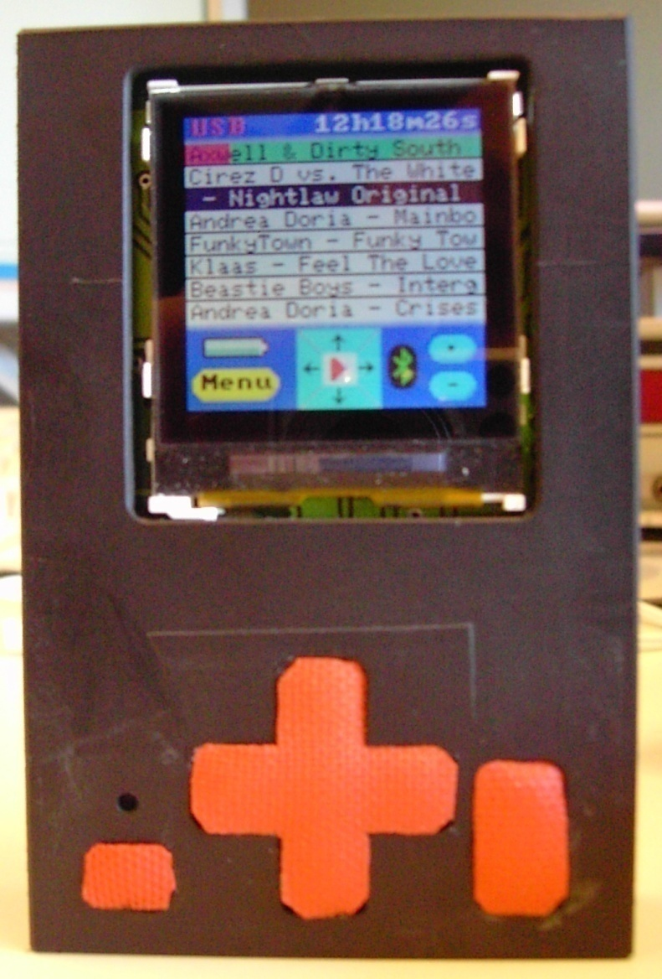
How to use the remote
UP
OK
LEFT
RIGHT
DOWN
Switch between menu / player mode
Increase / Decrease volume

Slide 9
Power
Lithium Ion battery (charged when USB is plugged)
LCD screen with power save modes (partial display…)
PWM on the LCD backlight (to vary its intensity)
LMX9838 with 3 different power save modes
Sleep / Wake up on the AT90USB1287
W681310 enable pin

Slide 10
Power
Power save mode : 17 mW
Backlight off, headset not plugged, no BT link : 94 mW
Backlight off, headset plugged, no BT link : 95 mW
Backlight on, no BT link : 277 mW
Backlight off, BT data link : 118 mW
Backlight on, BT data link : 307 mW
Backlight off, data & audio link : 177 mW
Backlight on, data & audio link : 347 mW

Slide 11
Autonomy (with the 620mAh bat)
Power save mode : 135 h
Backlight off, headset not plugged, no BT link : 25 h
Backlight off, headset plugged, no BT link : 24 h
Backlight on, no BT link : 8 h
Backlight off, BT data link : 20 h
Backlight on, BT data link : 7 h
Backlight off, data & audio link : 13 h
Backlight on, data & audio link : 6.5 h

Slide 12
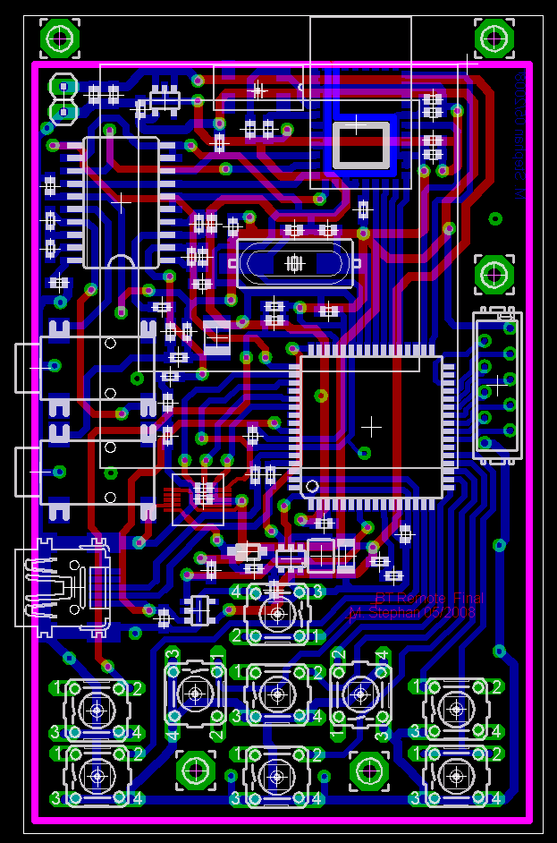
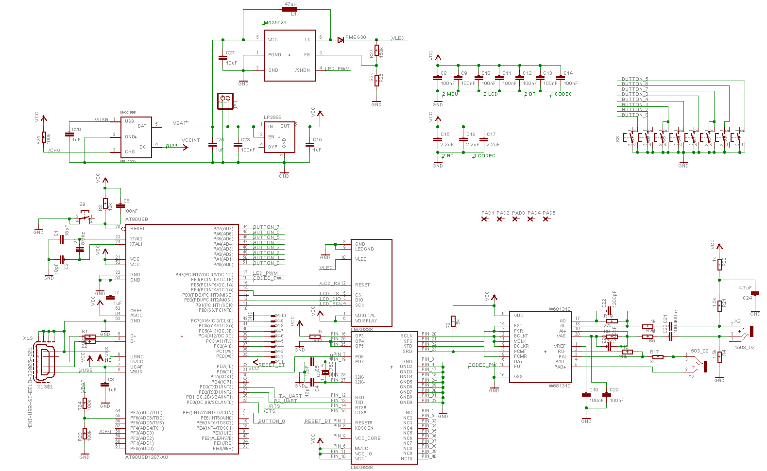
Work done (1/4) – System design
Printed circuit boards produced

Slide 13
Work done (2/4) – Firmware
LCD screen interfacing
Bluetooth module interfacing
Graphic library: pixel control, text, pictures, scrolling…
Actions needed at first boot: BT profile, audio config...
Protocol implementation for dialog with the media player
USB: implementation of a HID device
Power handling: power save modes, battery voltage sensing

Slide 14
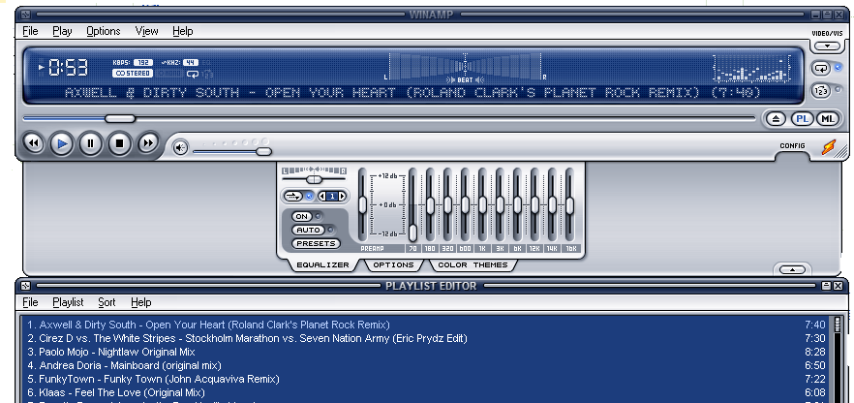
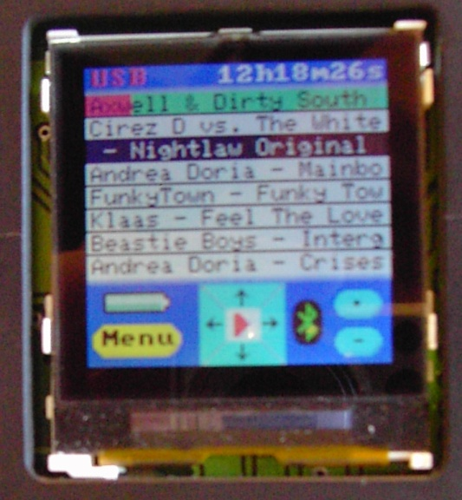
Work done (3/4) – plugin
Communicates with the remote control using a serial port over bluetooth
Decode the requests, send the appropriate answers (titles, playing status…)

Slide 15
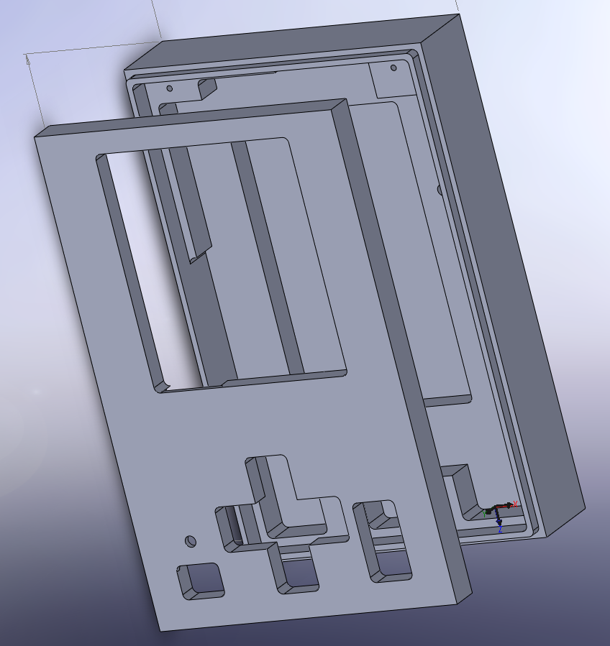
Work done (4/4) – the box
Designed using Solidworks
Produced using EPFL CNC machines

Slide 16
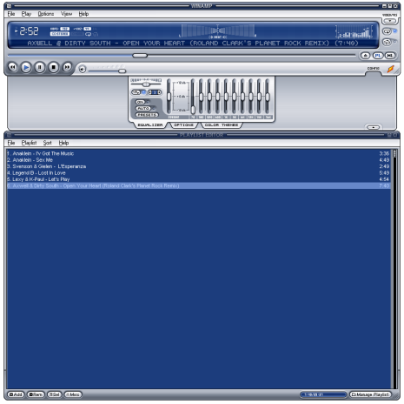
Communication overview
Bluetooth link
Get init
Remote
Titles to display
Init done
[Titles displayed]
What’s up?
User scrolling….
Nothing / title changed…
What’s after/before title X?

Slide 17
What has been done/improvements
Goal has been achieved (as you can have tested)
Printed circuit board can be reduced
Graphic library can be improved
Packaging can be better

Slide 18
Evolution
Everything: open platform, free tools, expansion port, Bluetooth and USB interfaces!

Slide 19
Any questions?
Thanks ☺

Slide 20
Work left to do (prev pres)
Final prototype with power elements
Audio Codec interfacing
Winamp plugin creation
Plugin’s messages parsing on the AT90USB
Benchmarks: speed / autonomy
Create a packaging

